Slide 1
Meijer-Dematic Discussion
Updated October 13, 2020

Slide 2
Agenda Topics
Tote Rates
Inputs / Approach
Tote Requirements Analysis
DMS inbound totes
Empty order store totes
Completed store totes
Supply tote returns to DMS
Next steps / discussion
Appendix (from previous meeting)
Team Intro
DF86 Berkshire Grey System Overview
DCD Software needs
SW Integration Needs
Timing
Mechatronics

Slide 3
Tote Rates Discussion

Slide 4

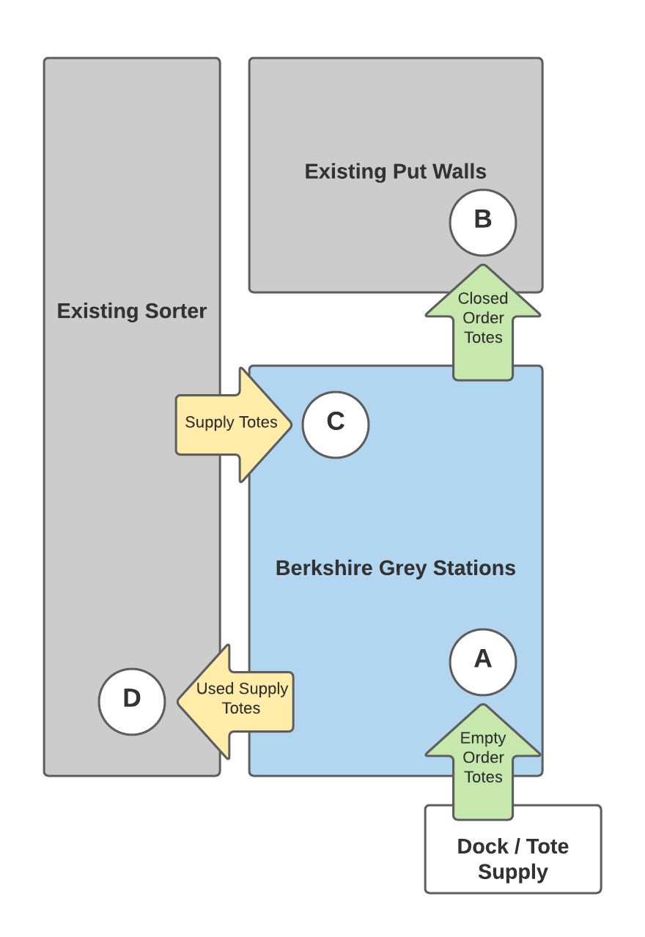
Tote flow requirements into and out of Berkshire Grey system
 | Flow | Throughput
A | Empty order totes from dock (Empty order store totes)
B | Closed order totes to put walls (Completed store totes)
C | Supply totes from sorter (DMS Inbound)
D | Used supply totes

Slide 5
Analysis Inputs / Approach Overview
 | Lansing ART System
Station throughput mPacks / hour | 1,150
Station count | 8
Container locations per station / total | 52 / 416
Source Files | cartonized_dlu-2020-02-17.xlsx (+2-26) NOTE: No tote sequence given – Expect reduction in requirements
Days Analyzed | 2/17/2020, 2/26/2020
Total Volume | 243,620 mPacks
OB Totes Generated | 16,843
Average mPacks / tote (supply)* mPacks | 22.45 18.73
Average mPacks / tote (order) mPacks | 22.78 14.46
BG Station Information
Data Used
Selected Metrics from Data
Analysis Approach
Assume OB totes processed in the same sequence as today
Set station capacity, process totes in sequence according to capacity
Look at SKU cube, compare to cube of supply tote, apply 85% packing to determine a theoretical packing quantity (covering air and residuals) to determine a mPacks / supply tote by SKU (*weighted by volume above)
Regarding supply tote delivery
SKU output for first instance of SKU on first order tote
Later order totes n ‘look back’ at previous output, if previous tote sequence number < n – 416, or if previous supply tote output does not have sufficient calculated quantity, assume a new output required

Slide 6
Original Hourly tote and case (mPack) movement for 8/26 – 9/1
Avg. 9,065
Avg. 1,844
1,034
Legend
Vol. Hrly.
Avg. 398
OB Totes Hrly.
Supply Totes Hrly
8/26/19
8/27/19
8/28/19
8/29/19
8/30/19
8/31/19
9/1/19

Slide 7
Hourly tote and case (mPack) movement for 2/17 and 2/26 8 Stations in Operation
Legend
Vol. Hrly.
OB Totes Hrly.
Supply Totes Hrly
2/17/20
2/26/20

Slide 8
Order (ART) totes, throughput requirements
Order totes from dock into Berkshire Grey
Order totes from Berkshire Grey into put walls
Assumed to be same as completion sequence, albeit offset
Significant buffer between dock and tote prep station
Additional buffer after tote prep station and before BG stations
Based on order tote completion sequence, with quantities
Requirement derived from hourly throughput of system
1,150 mPacks / hr * 8 cells = 9,200 / hr total
Order totes processed in sequence, driven by total station capacity
Buffering in and out of BG system
Propose buffering multiple takeaways for surges
Requirement | Order totes / hour
Average | 398 624
Requirement | Order totes / hour
Average | 398 624
Max | 477 738

Slide 9
Supply (inventory) totes, throughput requirements
Supply totes from sorter into Berkshire Grey
Supply totes from Berkshire Grey into sorter
Based on algorithm described on slide 10
Considers calculated tote quantities, existing outbound tote processing sequence
Assumes tote rationalization
Partial totes picked first
Opportunities likely exist for optimization in Dematic
On average, supply totes flow back to Dematic at the same total rate as they are fed to BG
Significant buffering via
Supply tote conveyor to sorter
DMS infeed lines
Decant into empty totes, induction
Also looked at totes with contents vs. totes picked clean (again, assuming tote rationalization)
Requirement | Supply totes / hour
Average | 1,844 3,725
Max | 3,222 4,807
Requirement | Supply totes / hour
Average | 1,844 3,725
% totes w/ residual contents (Average totes per hour) | 81.6% 88.0% (1,504) (3,277)

Slide 10
Tote flow requirements into and out of Berkshire Grey system 8 Stations in Operation
 |  | Throughput
 | Flow | Average | Max
A | Empty order totes from dock | 398 | (Buffered)
B | Closed order totes to put walls | 398 | 477
C | Supply totes from sorter | 1,844 | 3,222
D | Used supply totes | 1,844 | (Buffered)
8/26/2019 – 9/19/2019
8 Stations
 |  | Throughput
 | Flow | Average | Max
A | Empty order totes from dock | 624 | (Buffered)
B | Closed order totes to put walls | 624 | 738
C | Supply totes from sorter | 3,725 | 4,807
D | Used supply totes | 3,725 | (Buffered)
2/17/2020, 2/26/2020
8 Stations
Requirements derived from historical data without actual sequencing / batching, system should be sized appropriately for additional variability and growth, dependent on total DMS capacity

Slide 11
Hourly tote and case (mPack) movement for 2/17 and 2/26 6 Stations in Operation
Legend
Vol. Hrly.
OB Totes Hrly.
Supply Totes Hrly
2/17/20
2/26/20

Slide 12
Tote flow requirements into and out of Berkshire Grey system 6 Stations in Operation
 |  | Throughput
 | Flow | Average | Max
A | Empty order totes from dock | 398 | (Buffered)
B | Closed order totes to put walls | 398 | 477
C | Supply totes from sorter | 1,844 | 3,222
D | Used supply totes | 1,844 | (Buffered)
8/26/2019 – 9/19/2019
8 Stations
 |  | Throughput
 | Flow | Average | Max
A | Empty order totes from dock | 468 | (Buffered)
B | Closed order totes to put walls | 468 | 543
C | Supply totes from sorter | 2,794 | 3,915
D | Used supply totes | 2,794 | (Buffered)
2/17/2020, 2/26/2020
6 Stations
Requirements derived from historical data without actual sequencing / batching, system should be sized appropriately for additional variability and growth, dependent on total DMS capacity

Slide 13
Appendix

Slide 14
DF86 System Overview

Slide 15
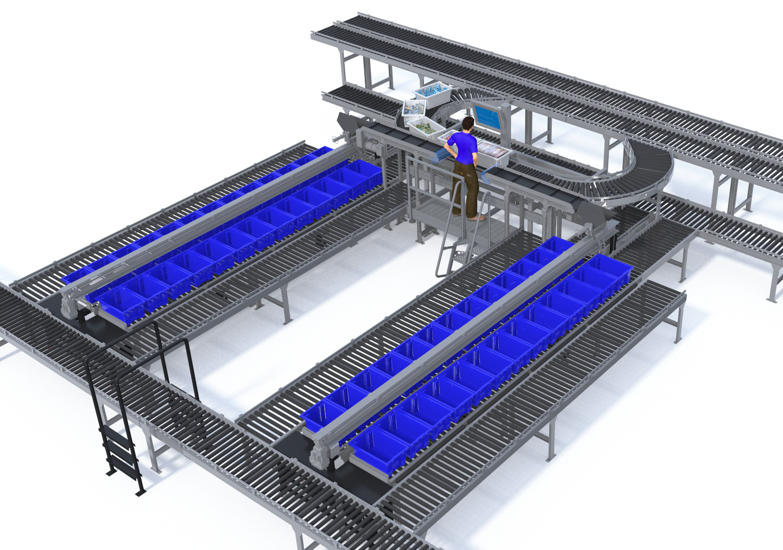
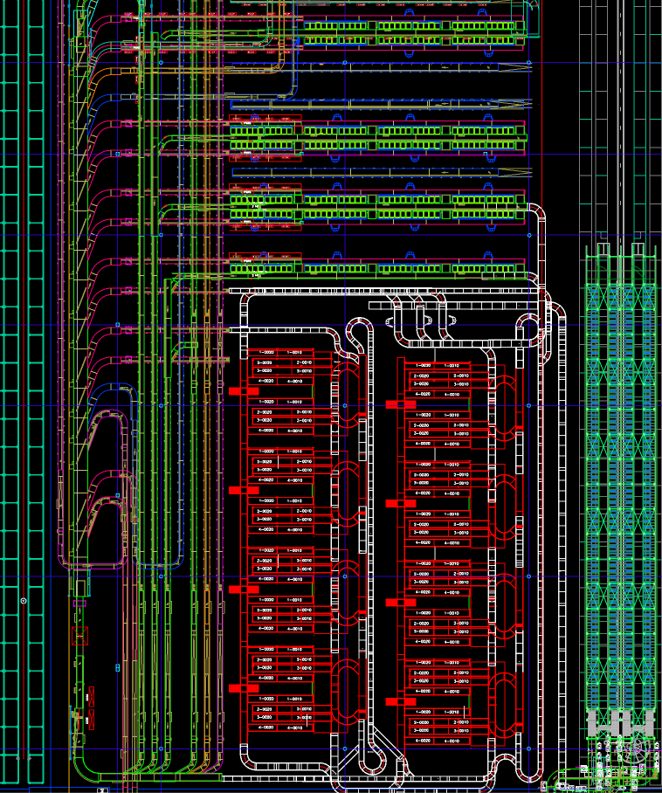
System Overview
Dual-Wing Manual Station Overview
DF 86 Deployment
1
Deployment / System Overview
Project entails 8 Dual-Wing Stations deployed in current tote staging area, with supporting tote conveyor (white conveyor)
Leverages existing ART infrastructure for supply and order totes
Dual-Wing stations serve as put wall replacements
Opportunity to expand and/or add robotic picking the future
5
3
2
OB Totes Depart
3
Supply Totes
Arrive
Tote Workstations
4
 | Totes fed to stations via BG conveyor network
 | Operator places mPacks to intermediate conveyors
 | Intermediate conveyors transfer mPacks to shuttles, shuttles deposit to totes
 | Completed store totes ejected and sent to closing stations
 | Supply totes leave station and route to additional stations or return to storage
1
2
OB Totes Enter
3
4
Supply Totes
Depart
5

Slide 16
SW Integration Needs

Slide 17
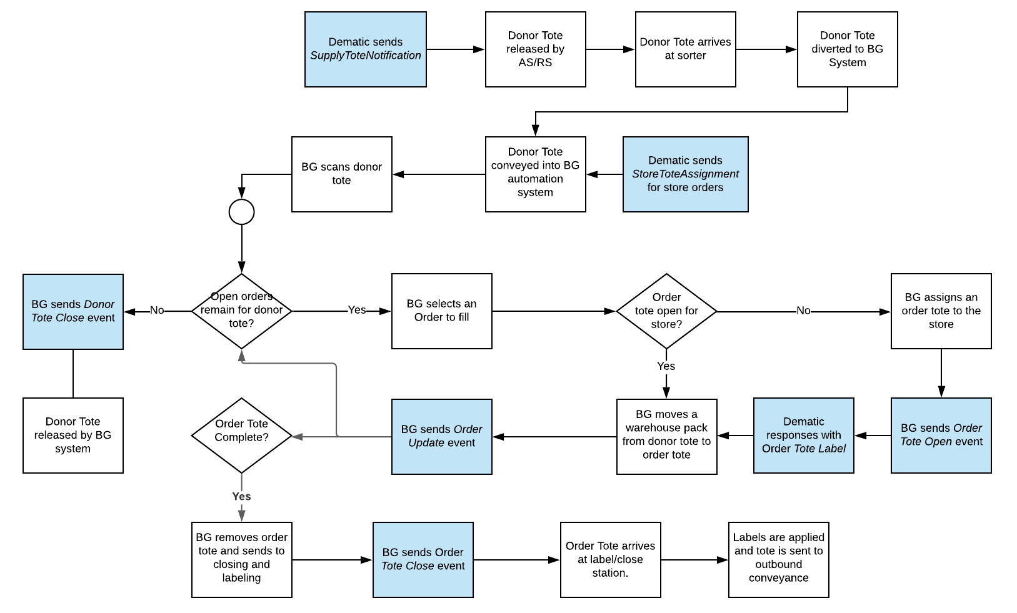
Example Integration
Material / Data Flow
(White / Blue Boxes, respectively)
Protocols currently supported by BG abstraction layer
Ethernet
Sockets-Based
TCP
UDP
Event-Based
Kafka
ZeroMQ
Request-Response
JSON RPC
XML RPC
Protobuf3 gRPC
Query API
REST
GraphQL
Example topics to be covered during design phase
Label Printing
Exception handling
No order for tote
No empty order tote positions available
Unknown supply tote

Slide 18
Standard RSR Interfaces
Area | Message | Direction |  |  | Trigger | Purpose | Comment
Admin | Heartbeat | BG | <--> | WCS | Fixed Interval | Used to keep the connection between the RSR and the WCS alive.
Admin | Cell Status | BG | ---> | WCS | Status change | Indicates operational status of a specific RSR unit | Information typically used by WCS to understand station availability
Inbound | Supply Tote Notification | BG | <--- | WCS | Tote sent to BG | Notify BG of inbound supply tote
Inbound | Store Tote Assignment | BG | <--- | WCS | Order tote assigned for fulfilment | Notify BG of order tote requirements
Inbound | Item Information | BG | <--- | WCS | Item data modified | Conveys information about items to be picked by the RSR | Includes robotic picking compatibility Sent per Item, or possibly included in Container assignment (when header processed?)
Outbound | Container Status | BG | ---> | WCS | New container | Updates information about an outbound container
Outbound | Order Update | BG | ---> | WCS | Picks / puts | Describes progess in fulfilling requested order
Outbound | Store Tote Complete | BG | ---> | WCS | Container completed | Indicates that BG has completed processing the Store Tote

Slide 19
Project Timing

Slide 20
High-Level Integration / Program Timing
Proposed integration timeline / milestones
Current phase
SOW Completion
Integration Design
Development / Test
Onsite Install
Timeline
Current
Q4 2020
Q1 2021
5/1/2021
Key activities
High-Level Alignment
Confirm timing
Detailed integration design
Align on dev. / testing methodologies
Development completion
Integration testing completed (offsite)
Berkshire Grey equipment installed
Onsite system integration
Deliverables
Directional approval on approach
Dematic integration scoping
Integration specifications
Integration test plans
Validated interfaces
Fully-integrated systems
Production Go-Live (6/30/2021)

Slide 21
Next Steps
Feedback on analysis, align on requirements
Dematic response to expected flow requirements
Dematic generate ROM for integration

Slide 22
Appendix System Details

Slide 23
Proposed System: Semi-Automated Workstation Concept of Operations
Semi-automated store replenishment station concept of operations
Infeed
Homogeneous totes routed via central ticketing to store replenishment station
Singulation
Associate is directed to place single units from donor totes onto one of two cleated conveyors
1
2
Transfer
Cleated conveyor transfers units into shuttle bucket for sortation
3
Completion
Completed totes are kicked to take-away conveyor routed to packing stations
Sortation
Shuttle traverses out and places units into appropriate store container
5
4

Slide 24
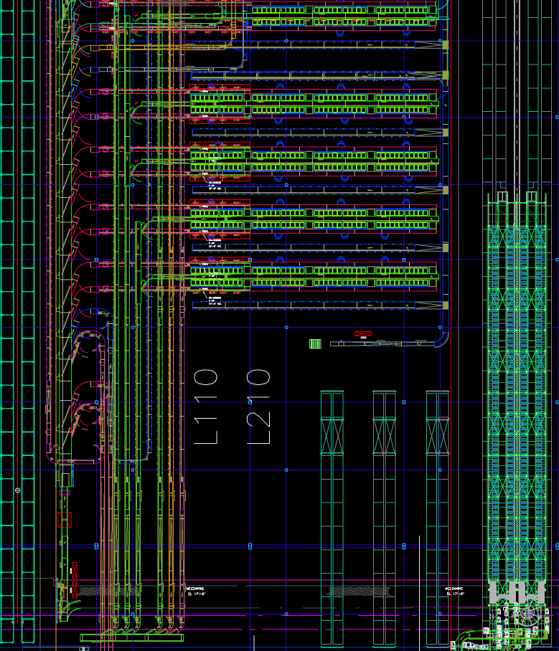
System Layout for 8 Semi-Automated
High-level view of targeted area
Semi-Automated RSR deployment
Objectives
Minimize impact on operations during deployment
Subset of put walls to remain
Maintain operational access
Leverage existing MHE where possible
Single-phased deployment
Berkshire Grey Scope
8 RSR units
All supporting conveyors
Software, IT hardware
Deployment costs
Contingency for unexpected changes
OB Totes Depart
Supply Totes
Arrive
Tote Workstations
OB Totes Enter
Supply Totes
Depart

Slide 25
Appendix Integration Overview

Slide 26
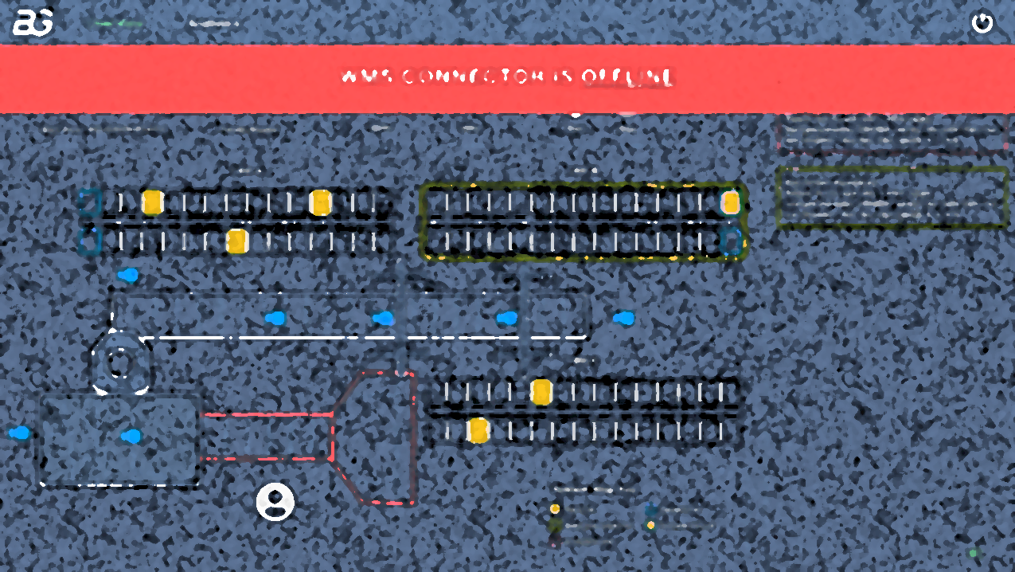
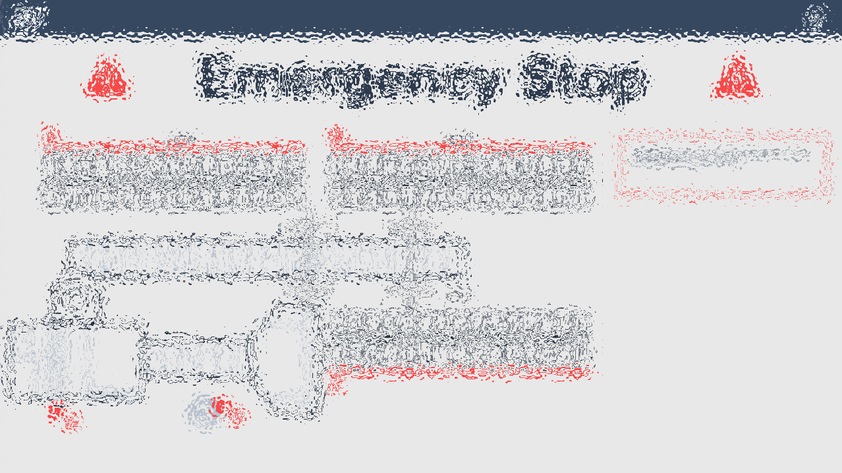
Triage / Troubleshooting between Berkshire Grey / Dematic Scope
Physically and logically, there is a relatively clear delineation between Berkshire Grey (BG) and Dematic equipment / scope
In other engagements, BG is responsible for the ‘black box’ containing the sortation equipment, as well as the box and tote conveyor networks therein
BG reports on ‘system availability’ by type to understand accountability and troubleshooting under various scenarios
When performance falls below expectation, BG will report on any contributing events to this occurrence
‘External starvation’ are instances when the BG system cannot perform its functions due to events outside of its control
OB tote backup (orders unable to close at cells)
IB tote unavailability (lack of supply totes at cells)
BG would propose using sensors to detect and report on these occurrences (OB line blocked for X minutes; IB has seen no totes for Y minutes)
Other events fall within BG scope
Internal starvation (totes waiting on routing in ‘black box’)
Intervention required (fault / jam waiting on operator)
Reporting Option 1: Data / Event-Based Reporting
Raw operational data available to Meijer team via network
Accessible through Meijer’s reporting tool of choice
Note – General applicability for reporting
Could also be reported to existing (Dematic) WCS, or other warehouse monitoring tools
Reporting Option 2: Canned Reporting / Dashboard
Berkshire Grey provisions a BG ‘monitor’ dashboard including these (and other) events, as well as productivity reporting

Slide 27
Appendix Additional Message Details

Slide 28
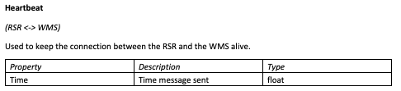
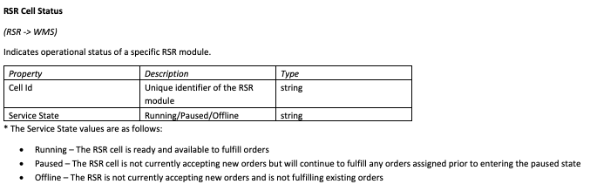
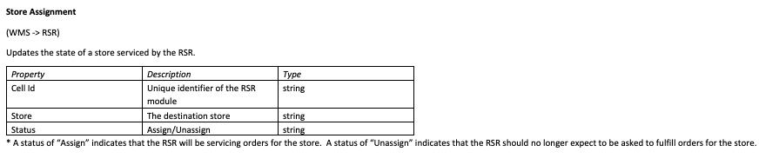
Admin Messages

Slide 29
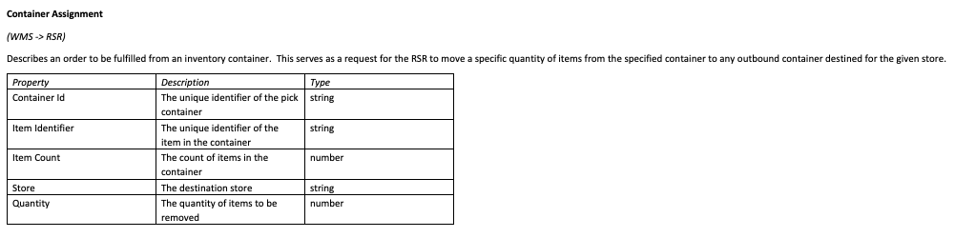
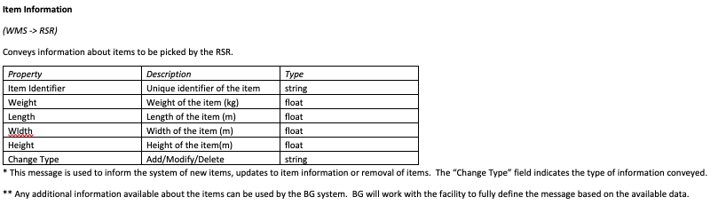
Inbound Messages

Slide 30
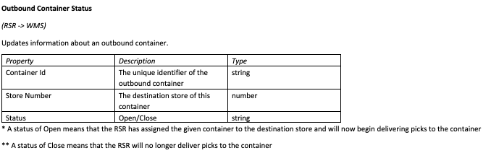
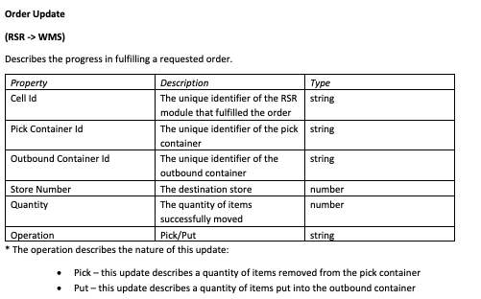
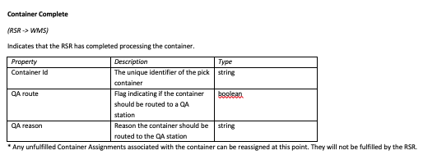
Outbound Messages

Slide 31
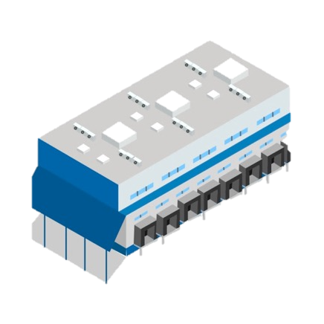
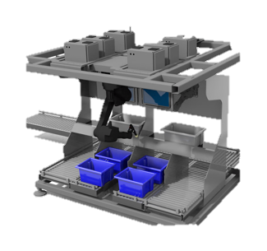

Through use of solution proxies, Berkshire Grey systems have great flexibility in protocols and integration schemes
Warehousing Platform(s)
WMS/WCS/WES
Currently Supported Protocols
Berkshire Grey
Abstraction Layer
Berkshire Grey
Solution
Ethernet
Sockets-Based
TCP
UDP
Event-Based
Kafka
ZeroMQ
Request-Response
JSON RPC
XML RPC
Protobuf3 gRPC
Query API
REST
GraphQL
Custom-Created Proxy
Allows focus on importance of message definitions
Not limited to integration with Warehouse Platform
CMMS integration
Metrics Aggregation / Reporting
Integration
Infrastructure
InfoSec
SW Updates

Slide 32
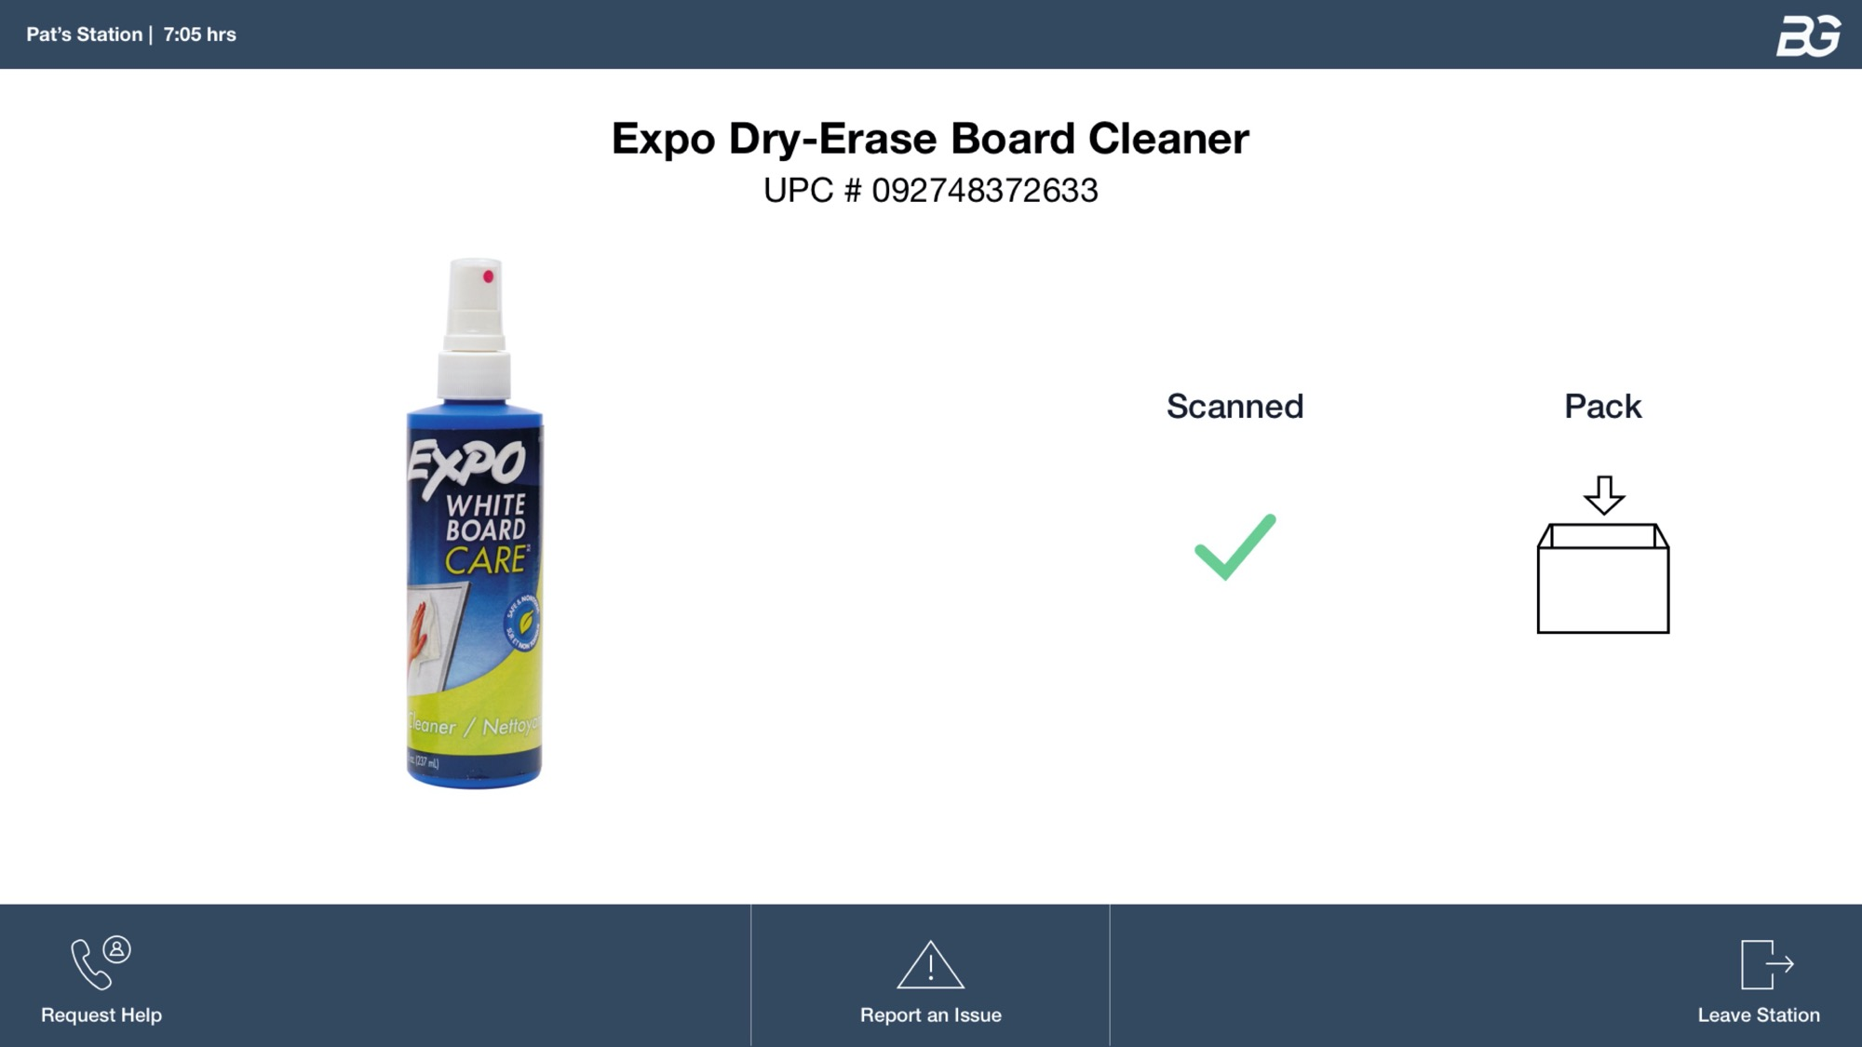
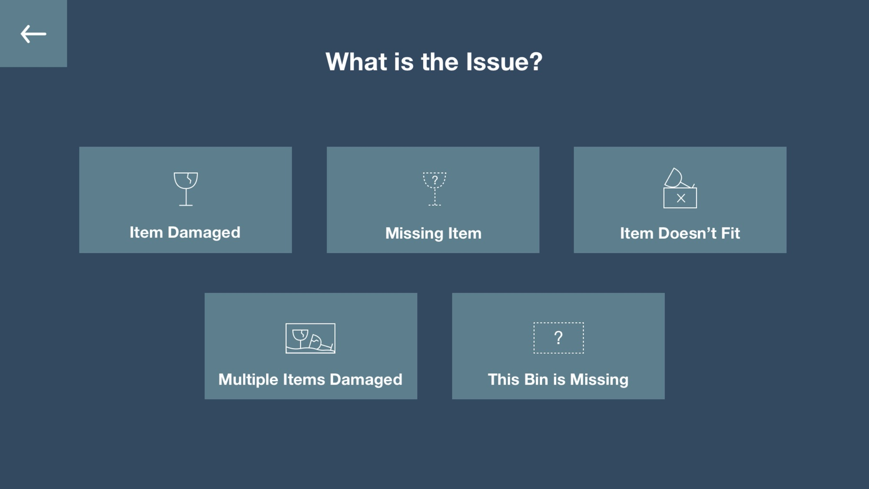
User Interfaces
User Interfaces at Workstations
Management User Interfaces
Positioned at individual SASR stations
Requirements / features:
User login, tracking
Task direction
Quality checks
Error handling
Available at workstations and/or on mobile, for general system oversight
Requirements / features:
Overall system status
Component (i.e. individual SASR) statuses
System and component productivities
Next Steps
Berkshire Grey will propose user interfaces during detailed design process
Meijer will provide feedback
Interfaces completed prior to installation
Strip down to just triage
Jen provide example (?)

Slide 33
Appendix Timeline Overview

